Slide 1
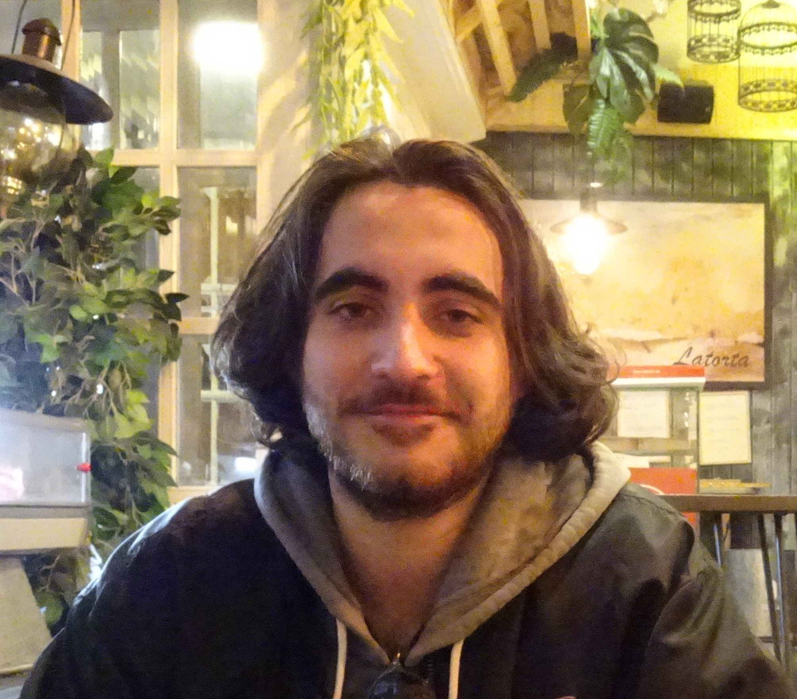
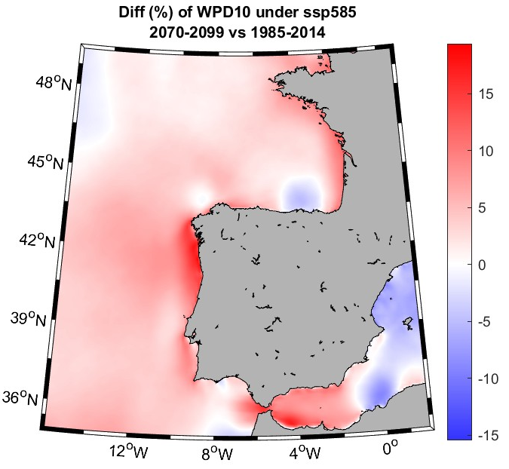
Brieuc Thomas
University of Vigo
Nationality: French
Orientation: Technological progress. Engineering and Business Management
Specialization Area: Energy
Research Area: 4.9 Alternative energies
Foto doctorando
PhD project: Regionalización de proyecciones climáticas e implicaciones sobre las energías renovables
Supervisors: Dr. Jorge Costoya Noguerol (Universidade de Vigo)
Dr. Ramón Gómez Gesteira (Universidade de Vigo)
Summary: The main goal of this PhD is to realize a downscaling of various CMIP6 Global Climate Models (GCMs) using the WRF (Weather Research and Forecasting) meteorological model. In other worlds, low resolution data from CMIP6 GCMs will be used as input for WRF in order to obtain atmospheric data with a higher resolution in chosen areas. The output data might be used in order to determine which zone would be better for harnessing offshore wind energy.
The results (such as wind data) given by WRF model might also be used as input data for wave models (WAVEWATCHIII, SWAN) in order to harness wave energy.
Foto relacionada con el tema de tesis

