Slide 1
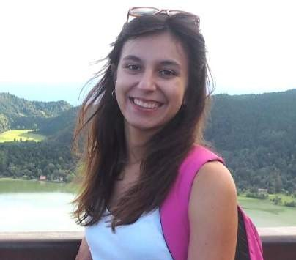
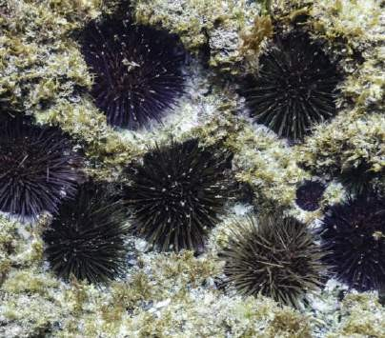
Elisa Osorio Novas University of Vigo Nationality: Spanish
Orientation: Sustainable use of Marine Resources Specialization Area: Aquaculture
Research Area: 2.10 Animal welfare
PhD project: Parasite fauna and parasite-host relationships in the sea urchin, Paracentrotus lividus: implications for culture and conservation.
Supervisors: Dr. Raúl Iglesias Blanco (Universidade de Vigo)
Dr. José Manuel García Estévez (Universidade de Vigo)
Summary: Gastronomic interest in sea urchin gonads has increased considerably due to their excellent culinary and nutritional properties. In southern Europe, the most commercially exploited and wild-collected species is Paracentrotus lividus, whose gonads are considered a gourmet delicacy and one of the most expensive fishery products on the market. However, overexploitation of this resource has led to the collapse of certain natural stocks.
The continuous increase in the consumption of sea urchin gonads has triggered interest in the production of these echinoderms through aquaculture, in order to meet their growing demand in a sustainable way. From this perspective, knowledge of parasites affecting natural sea urchin populations is particularly important since some of these organisms could cause pathologies under captive production conditions, where the population density of hosts and culture conditions could facilitate their transmission and development. This type of parasitic infections can also compromise the conservation of the resource in certain areas, causing a significant alteration of the ecosystem where these echinoderms live.
The aim of this work is to characterise the identity of these parasites, their biological cycles, and the relationship of these organisms with their host, which could help to foresee the appearance of possible epizootics in aquaculture farms and to design preventive measures aimed at minimising their possible impact on the survival of these animals.

