Slide 1
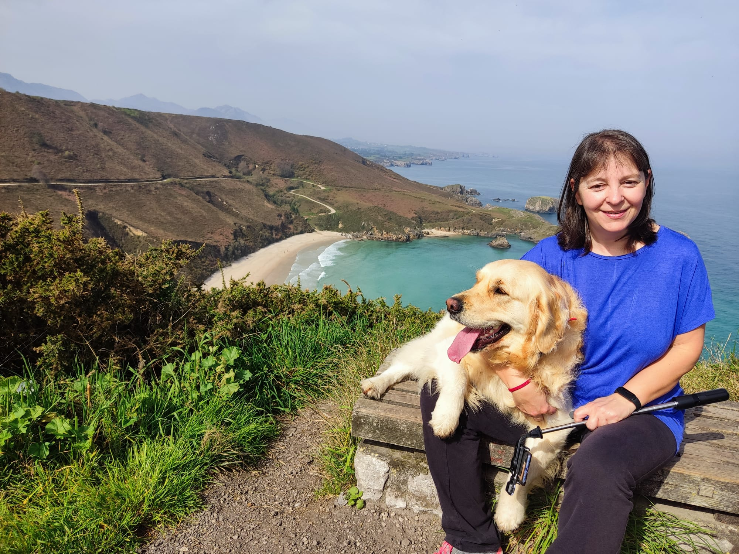
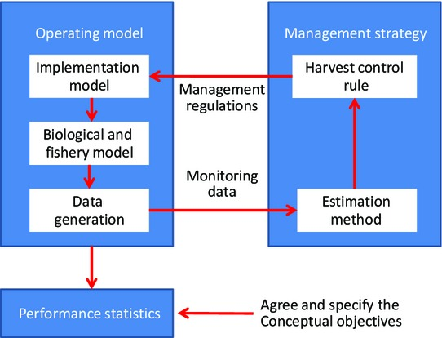
González Troncoso, Diana María
University of Vigo, Spanish Oceanographic
Institute
Nationality: Spanish
Orientation: Sustainable Use of Marine Resources
Specialization Area: Management and Use of Resources
Research Area: 2.3. Assessment of fish and shellfish resources
PhD project: Management strategies in fisheries. Case Study: NAFO 3M Division Cod
Supervisors: Dra. María Ruiz Soto (Spanish Oceanographic Institute)
Dra. Grazia Pennino (Spanish Oceanographic Institute)
Summary: The main objective of fisheries management is to ensure that fishing is sustainable over time and does not deplete marine resources. A series of measures and actions are implemented to manage and preserve fishery resources in a sustainable manner. The fisheries management system faces several problems in decision-making and effective implementation of measures, due to the uncertainty that affects each of its components. Fishery assessment models must be flexible and able to adapt to the availability of information to quantify uncertainty, and fisheries management has to be adaptive according to the results of the assessment and the evolution of uncertainties.
Management Strategy Evaluation (MSE) is recognised as the best tool for providing advice. MSE allows to anticipate, through simulation, the outcome of different stock management strategies and to identify their robustness under different uncertainty scenarios. The results of MSE can be used as a basis for decision-making by fisheries managers and other stakeholders, as well as for reaching consensus on management objectives and strategies.
The main objective of this thesis is: a) to carry out an exhaustive review of the best practices for developing MSE using NAFO Division 3M cod as a case study; b) to review and compare the main software available for the application of MSE; and c) to apply MSE to the case study for different types of management rules based on a selection of operational models suitable for different types of uncertainty. The objective will be achieved through the development of three papers with a common thread, so that each of them will be a chapter of the thesis.

