Slide 1
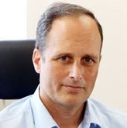
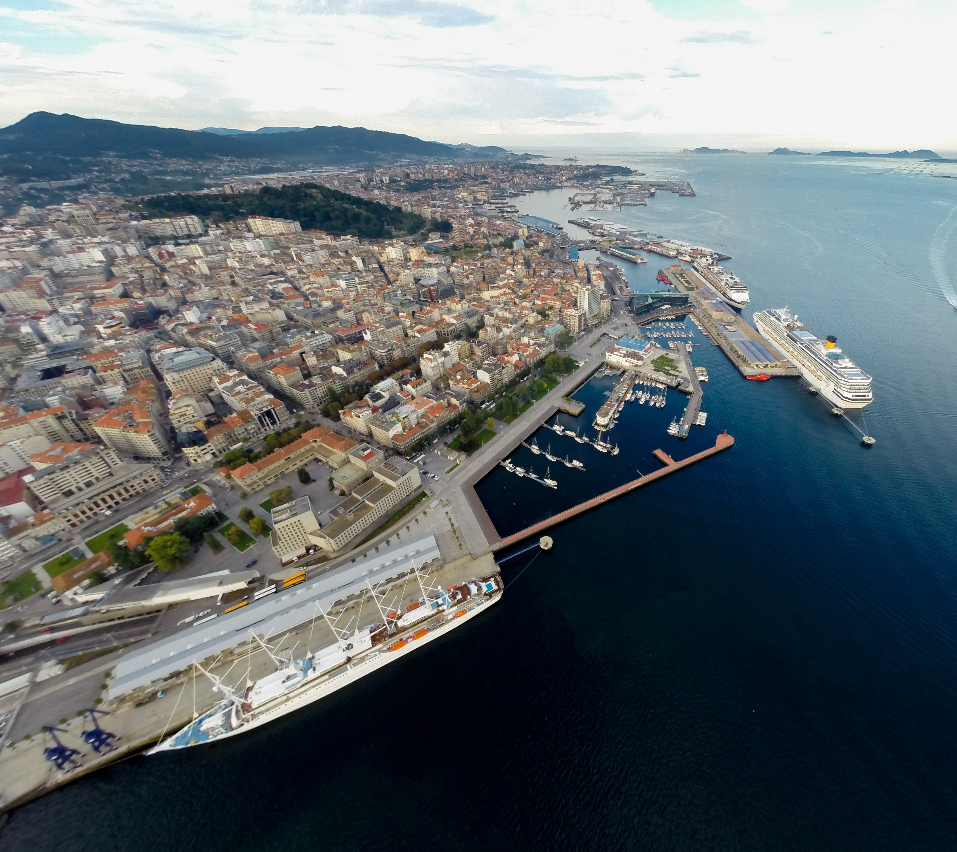
Carlos Botana Lagarón
University of Vigo
Nationality: Spanish
Orientation: Technological Progress, Engineering and Business Management
Specialization Area: Port Infrastructures, Management & Maritime Transport
Research Area: 4.1 Projects and Design of maritime works. Logistics and safety
PhD project: Climate change mitigation measures in ports
Supervisors: Dr. Emilio Fernández Suárez (Universidade de Vigo)
Dr. Gumersindo Feijoo Costa (Universidade de Santiago de Compostela)
Summary: The carbon footprint (CF) has become a crucial piece in the development of strategies to address the problem of climate change. Its implementation allows establishing a path towards decarbonization with the aim of complying with European and global guidelines and commitments on greenhouse gas (GHG) emissions.
Currently, several tools are available to calculate CF. However, differences in the methodology of calculation and data collection prevent comparative studies based on the results obtained. For this reason, CEDEX (Center for Studies and Experimentation of Public Works), commissioned by Puertos del Estado, prepared a guide of good practices with a common methodology for calculating the FC of Spanish ports. In this study, we tested this standardized methodology for the first time in the Port of Vigo (NW Spain) over a period of four years (2017-2020), developing a web tool to facilitate its application, with the ultimate goal of extending its implementation nationwide.
With the implementation of the methodology developed in this study, a 55% reduction in GHG emissions could be achieved in all port activities, thus meeting the objectives of the European Green Deal for 2030.
In addition, this doctoral thesis designs a decision-making tool for compliance with European and global commitments to decarbonize the “ports of the future”. The tool reviews and analyzes the existing technologies for the decarbonization of a port taking into account four dimensions: environmental, economic, social and technological. The tool has been tested in the Port of Vigo through a practical case of designing a zero emissions port with energy sovereignty.

